Slide 1
Test Automation Using Selenium

Slide 2
Contents
Introduction to test Automation.
Drawbacks of Manual Testing
When does test Automation make sense?
Introduction to Selenium
Selenium Components

Slide 3
Test Automation
The process of converting the manual test cases to test scripts by using any automation tool is known as Automation.

Slide 4
Drawbacks of Manual Testing
Manual testing is not accurate at all times due to human error, hence it is less reliable.
Manual testing is time-consuming, taking up human resources.
Manual testing is only practical when the test cases are run once or twice.

Slide 5
When Does Test Automation make sense?
When there are many repetitive tests
When there are frequent regression testing iterations
When you need to simulate large number of users who are using the application resources
When AUT is having comparatively stable UI
When you have large set of BVT cases
When you can’t rely on manual test execution for critical functionality

Slide 6





Test Automation Tools
Selenium (Open Source)
Quick Test Professional By HP
Silk Test By Borland
Watir
Sahi

Slide 7
Selenium
Selenium is one of the most popular automated testing suites.
Selenium is designed in a way to support and encourage automation testing of functional aspects of web-based applications and a wide range of browsers and platforms.

Slide 8
Why Selenium ?
It is free and open source.
Have cross browser compatibility (Firefox, chrome, Internet Explorer, Safari etc.
Have great platform compatibility (Windows, Mac OS, Linux etc.)
Supports multiple programming languages (Java, C#, Ruby, Python, Pearl etc.)
Saves time and money, manual effort.
We can maintain Accuracy by repeating the same task in same manner.
Have a large user base and helping communities

Slide 9
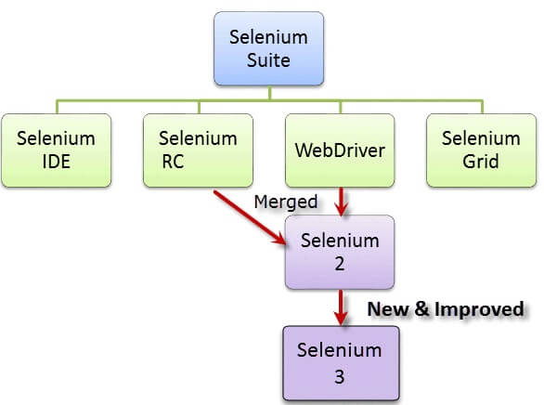
Selenium Components
Selenium Integrated Development Environment (IDE)
Selenium Remote Control (RC)
WebDriver
Selenium Grid

Slide 10
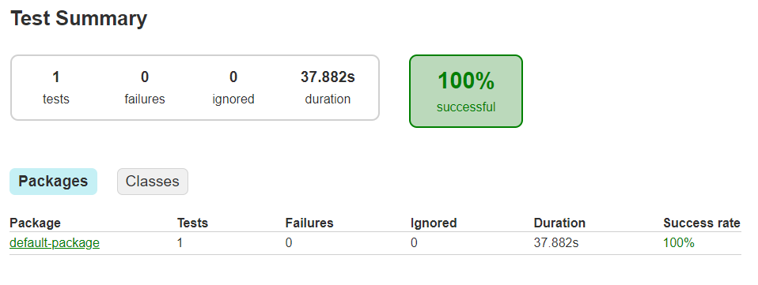
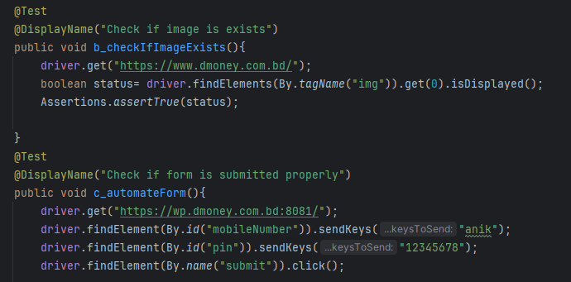
Implement

Slide 11
Thank You

